Slide 1
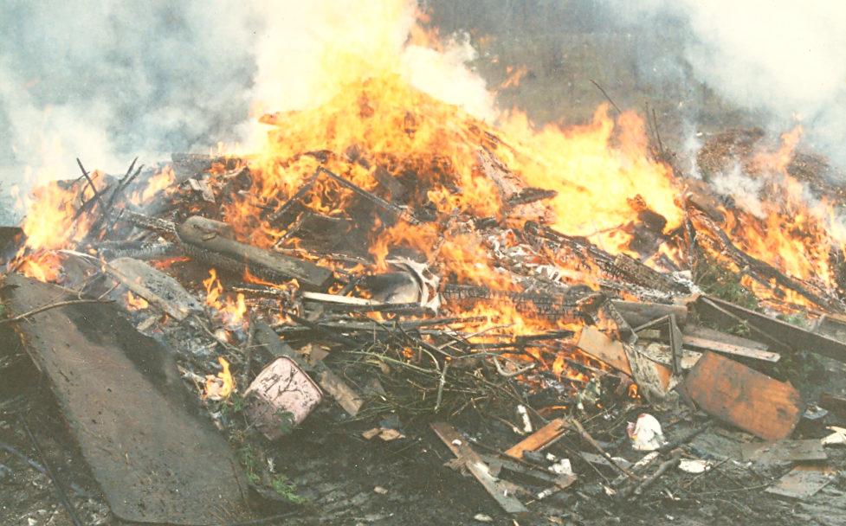
OPEN BURNING (and “incineration” too)
Information for Town Health Officers
Dave Shepard, November 2014

Slide 2
Open burning—What is it?
Regulatory definition: Burning of materials where the gases are emitted to the open air without passing through a stack, chimney, vent or other restriction.
Examples:
Burning in piles on the ground
Burning in “burn barrels”
Burning in any open topped container

Slide 3
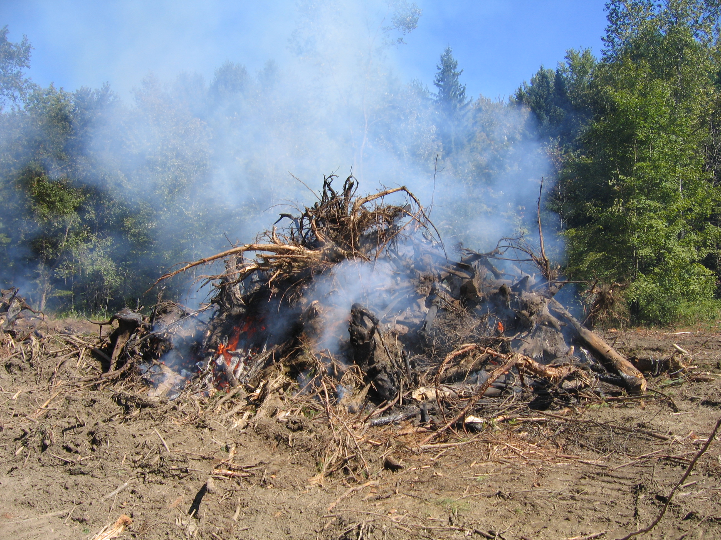
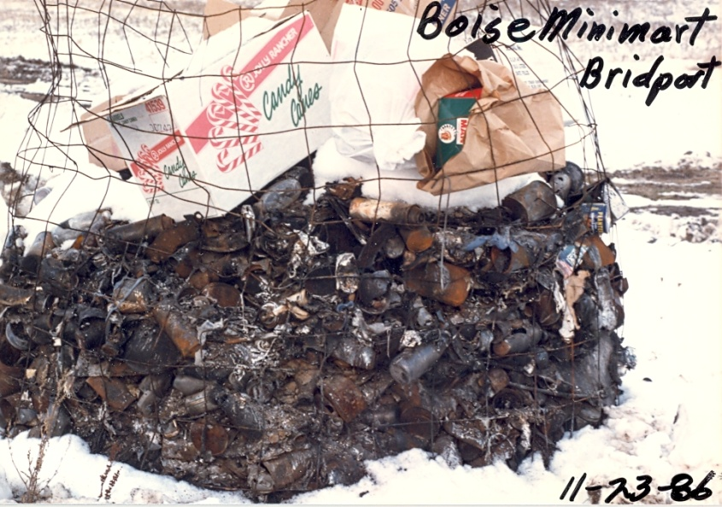
Open burning examples

Slide 4
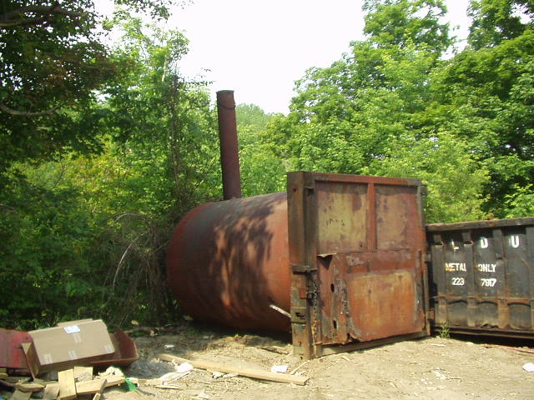
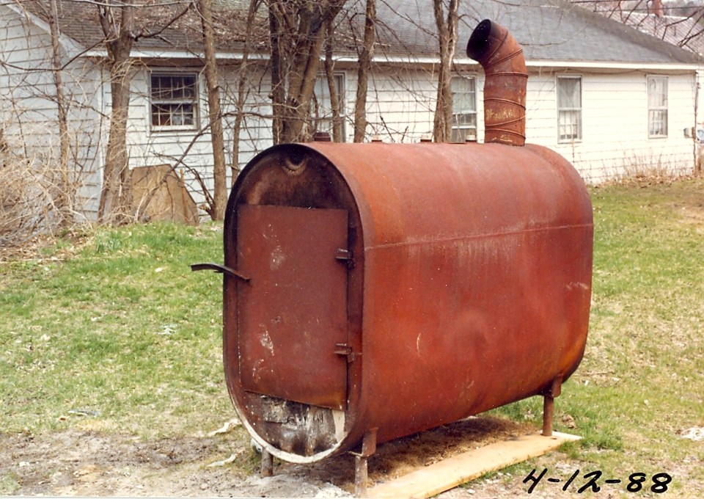
Incineration
Where the smoke emitted through a stack or vent (falls under different laws & regulations).
Examples:

Slide 5
Why Are We Concerned
Open burning causes wildfires
Open burning causes nuisance to neighbors and is particularly bad for children and elderly
Open burning releases toxins causing health and environmental impacts
Open burning releases particulates impairing general air quality
Esthetic impacts

Slide 6
Toxins Released By Open Burning
Fine particulate matter
Sulfur dioxide
Carbon monoxide
PAHs
Chlorobenzenes
Metals
Dioxins
Numerous others

Slide 7
Why is open burning particularly bad???
Low temperature combustion that forms large amounts of partial combustion products
Trash/garbage contain synthetics that produce dangerous chemicals
Chlorinated plastics: dioxin, phosgene, hydrogen chloride, etc
Nylon: cyanides
Plastics: benzene, styrene, toluene, phenol

Slide 8
Fine Particulate Matter (PM2.5) Health Effects
increased respiratory symptoms, such as irritation of the airways, coughing, or difficulty breathing;
decreased lung function;
aggravated asthma;
development of chronic bronchitis;
irregular heartbeat;
nonfatal heart attacks; and
premature death in people with heart or lung disease.

Slide 9
Laws and Regulations
Vermont Air Pollution Control Regulations Sections 5-201 & 5-202
Vermont Solid Waste Regulations
Forest & Parks Laws: 10 §§V.S.A. 2641-2648
24 V.S.A. §2201: Throwing, depositing, burning, and dumping refuse; penalty; summons and complaint.
Solid Waste District ordinances
Local town/municipal ordinances

Slide 10
24 V.S.A. §2201: Throwing, depositing, burning, and dumping refuse; penalty; summons and complaint.
This statute states in part:
“(2) No person shall burn or cause to be burned in the open or incinerate in any container, furnace, or other device any solid waste without:
(A) first having obtained all necessary permits from the agency of natural resources, the district environmental commission, and the municipality where the burning is to take place; and
(B) complying with all relevant state and local regulations and ordinances.”
Used for minor open burning and solid waste incineration violations
Provides mechanism for towns and solid waste districts to issue tickets
Tickets are treated similarly to traffic tickets and are handled by the Vermont Judicial Bureau
Violators can lose their hunting/fishing license for failure to pay the assessed fine

Slide 11
Ticketing Authority
Three easy steps to help end trash burning in your community
Designate an enforcement officer(s) in your town and request an officer number through the Vermont Judicial Bureau.
2. Call the Vermont Judicial Bureau at (802) 295-8869 and speak to a clerk to request a ticket book.
3. Help educate community members about alternatives to trash burning.
For more information, visit www.dontburnvt.org and
www.anr.state.vt.us/dec/wastediv/R3/recycle
Call the Vermont Judicial Bureau at
(802) 295-8869 to request your ticket book to help end
trash

Slide 12
Air Pollution Control Regulations
5-101(66) "Natural Wood" -- for the purposes of these regulations, natural wood means
trees, including logs, boles, trunks, branches, limbs, and stumps, lumber including timber, logs or slabs, especially when dressed for use. This definition shall also include pallets which are used for the shipment of various materials so long as such pallets are not chemically treated with any preservative, paint, or oil. This definition shall not extend to other wood products such as sawdust, plywood, particle board and press board.

Slide 13
Vermont Air Pollution Control Regulations
Subchapter II. Prohibitions
5-201 OPEN BURNING PROHIBITED
(1) No person shall engage in any open burning except in conformity with the provisions of Section 5-201, 5-202, and 5-203.
(2) No person shall cause, suffer, allow or permit the open burning of garbage, tires, rubber, plastic, waste oil, asphalt materials, materials containing asbestos, or pressure treated wood, except as may be allowed under subsections (3) and (7) of Section 5-202

Slide 14
General Refuse Illegally Burned

Slide 15
Recently Burned Auto Tires

Slide 16
Air Pollution Control Regulations cont.
5-202 PERMISSIBLE OPEN BURNING
When not prohibited by local ordinances or officials having jurisdiction such as local, state or federal fire wardens or other fire prevention officials, the following types of burning are permissible, provided no public or private nuisance is created.
(1) Natural wood fires in conjunction with holiday and festive celebrations.
(2) Campfires, outdoor grills, and fireplaces for recreation or preparing of food.

Slide 17
Air Pollution Control Regulations Fire Training
(3) Burning of solid or liquid fuels or structures for the purpose of bona fide instruction and training of municipal, volunteer, and industrial firefighters in the methods of fighting fires when conducted under the direct control and supervision of qualified instructors. Said firefighters shall be residents of the State of Vermont or affiliated with the mutual aid systems within the State of Vermont. Notification by the fire training officer or the fire chief of the training exercise shall be made to the Air Pollution Control Officer on prescribed forms at least 14 days prior to the exercise.

Slide 18
Air Pollution Control Regulations Permissible Burning Continued
(4) Burning in forest land areas of brush, tree cuttings and slash when the cuttings accrue from logging or site clearing operations.
(5) Burning for the purpose of weed abatement; disease, forest fire and pest prevention or control; and for the purpose of agricultural, forestry or wildlife habitat management.
(6) On-premise burning of leaves, brush, deadwood, or tree cuttings accrued from normal property maintenance by the owner, his or her agent, or lessee thereof.
(8) Burning of natural wood in an area designated by the selectmen or city council, with the permission of the selectmen or city council of that municipality and the fire warden in that jurisdiction, and in conformance with the procedures outlined in Section 5-203 of these regulations.

Slide 19
Air Pollution Control Regulations Cont Burning: Air Pollution Permit Required
(7) Open burning, as follows, if prior approval in writing is obtained from the Air Pollution Control Officer. Approvals granted under this subsection shall be subject to such reasonable conditions as are necessary to avoid a nuisance or to protect the health, safety or comfort of the public. The requirement for approval in writing may be waived by the Air Pollution Control Officer and oral approval may be granted instead when, in his or her judgement, the impacts of the burning will be insignificant.

Slide 20
Air Pollution Control Regulations Cont Burning: Air Pollution Permit Required
(a) Burning in remote areas, of highly explosive or other dangerous, or unusual materials for which there is no other feasible method of disposal.
(b) Burning in remote areas of natural wood resulting from the construction or demolition of buildings and other structures originating from within the State.
(c) Fires to thwart a hazard which cannot properly be managed by any other means or that are necessary for the protection of public health.
(d) Burning of other combustible materials for which there is no other feasible method of disposal.

Slide 21
Construction/Demolition Debris—Air Pollution Permit Required

Slide 22
Major Enforcement Players
Local Fire Wardens and Fire Chiefs
Town Health Officers
Solid waste management districts
Environmental Enforcement Officers (EEOs)
Vermont Air Pollution Control Division
Vermont Solid Waste Management Program

Slide 23
What you can do as Health Officers
Receive and investigate complaints of minor open burning such as burn barrels or small brush fires.
Issue health orders if appropriate
Refer major illegal burning cases (large piles of refuse, whole structures etc) or repeat offenses to appropriate authorities such as the EEOs.
Education: Inform citizens regarding the health impacts of open burning and the laws and regulations.
Encourage your town and local solid waste districts to adopt ordinances limiting open burning.

Slide 24
Documenting Open Burning Incidents
Complainant name, address & phone
Alleged violator’s name, location & phone
Who started the fire? When?
Was a permit obtained from the Fire Warden?
How many people/households are affected?
Sensitive populations? Schools, day cares, elderly etc.
Type of materials being burned (photos are good).
How large is the burn pile—rough estimate is fine.
Frequency of open burning?

Slide 25
Site clearing burn

Slide 26
*Legal Open Burning Can also be a problem
Such as:
Brush and tree cuttings from property clean-up
Slash from logging or site clearing
Leaf or garden waste burning
Can cause major exposures and health issues
Work with landowner to reduce exposures
Encourage alternatives such as chipping or composting
Burn during better wind & weather conditions
Salvage larger wood for other purposes
Allow materials to dry before burning
*Note: Under state rules but local ordinances may differ

Slide 27
Support Resources
ANR Enforcement Division:802-241-3820 or:
http://www.anr.state.vt.us/dec/co/enf/enf-complaint.htm
Environmental Enforcement Officers (EEOs) District Map: http://www.anr.state.vt.us/dec/co/enf/pdf/eeo_districts.pdf
Air Pollution Control Division: 802-241-3840 or: http://www.anr.state.vt.us/air/index.htm
Don’t Burn Vermont website: http://www.dontburnvt.org/
Solid Waste Management Districts

Slide 28
Informational Resources
Don’t Burn Vermont website: http://www.dontburnvt.org/
USEPA Website: http://www.epa.gov/ttnatw01/burn/burnpg.html
US EPA PM website: http://www.epa.gov/pm/health.html
Amercian Lung Association: http://www.lungusa.org/associations/charters/new-england/
VT Air Quality Montoring: http://www.anr.state.vt.us/air/Monitoring/cfm/RealTimeData.cfm
VT Air Pollution Open Burning Website: http://www.anr.state.vt.us/air/Compliance/htm/Openburn.htm
Vermont Judicial Bureau: http://www.vermontjudiciary.org/GTC/judicial/default.aspx

Slide 29
Contact for questions or further information
Dave Shepard, Environmental Analyst
Vermont Dept. of Environmental Conservation
Air Quality and Climate Division
1 National Life Drive
Montpelier, VT 05602-3802
Tele: 802-272-4088 Fax: 802-828-1250
email: dave.shepard@state.vt.us
Website: http://www.anr.state.vt.us/air
General Air Pollution Number: 802-828-1288

