Slide 1
Vermont Agency of Natural Resources Rivers and Roads Training Program
Tier One: An Introduction to River Processes and Management
Developed in Partnership with
The Vermont Agency of Transportation

Slide 2
An Introduction To River Processes and Management
Training Overview
This training module presents an exploration of
rivers and the physical adjustments they undergo in response to changes on the landscape and to their channels;
the historic approaches to river management and their consequences; and
alternative management practices to minimize impacts on the stream processes that naturally maintain river stability.
Notes:
Revised V4

Slide 3
An Introduction To River Processes and Management
Training Organization
This training is organized into the following lessons and sections.
Lesson 1: An Introduction to Rivers
The Values of Rivers
Hydrologic and Sediment Regimes
Lesson 2: Understanding River Behavior
River Morphology
River Equilibrium
Channel Evolution
Lesson 3: Rivers and Human Developments
Flood and Erosion Hazards
Controlling the River to Resolve Conflicts
Lesson 4: River Management Going Forward
Managing For Equilibrium

Slide 4
An Introduction To River Processes and Management
Navigating This Training Module
This training is a self guided presentation containing a combination of static slides, narrated slides, short videos and a series of questions at the end of each section. This training is not intended as a tool for measuring knowledge. Accordingly, responses to questions are not recorded.
To advance slides, activate narrations and videos and view the answers to the questions, simply click where instructed by the text on the slide. You can “right click” to see more navigation options including going back, advancing to a selected slide or ending the training.

Slide 5
An Introduction To River Processes and Management
Why a Rivers and Roads Training Program?
Time and time again we are reminded how vulnerable our roads and bridges are to apparently unpredictable river instabilities.
River processes are not as unpredictable as they may at first seem, we understand what causes rivers to be unstable.
We can use our understanding of river processes to reduce flood related damages and associated rebuilding expenses to our roads and bridges.
The Rivers and Roads Training Program aims to provide participants with this understanding of river processes.
Notes:
Revised V4

Slide 6
Lesson 1: An Introduction to Rivers

Slide 7
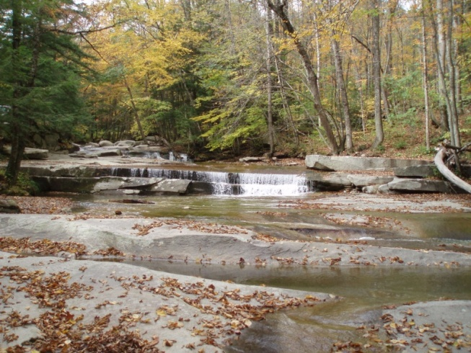
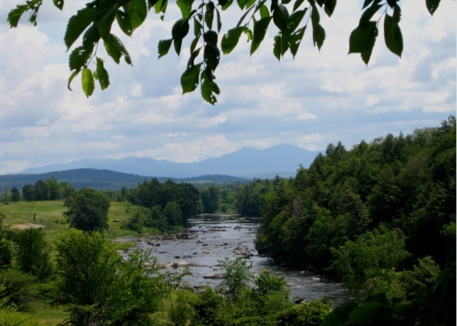
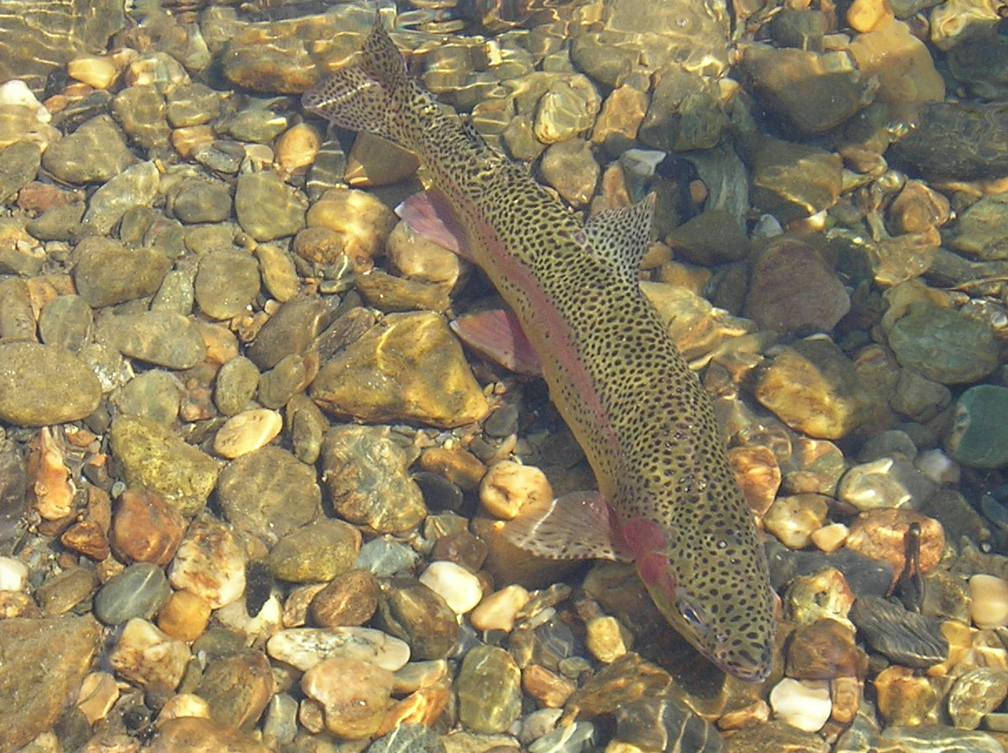
The rivers of Vermont are an important asset to all Vermonters. And managing them for long term health is in our collective best interest.

Slide 8
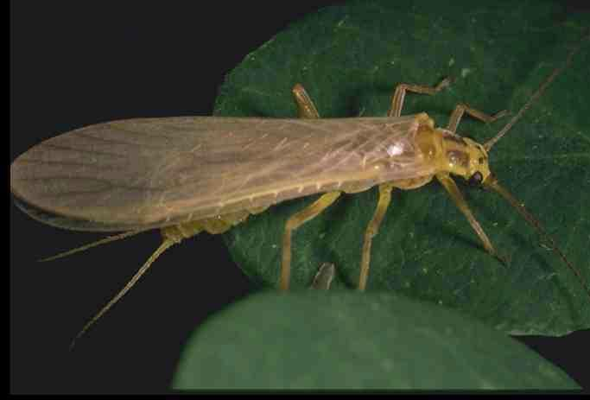
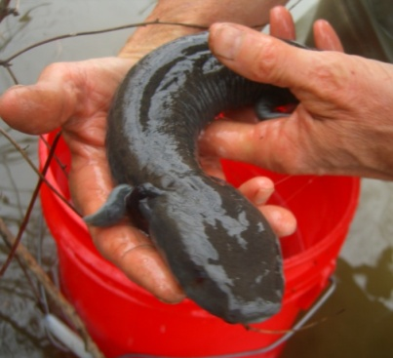
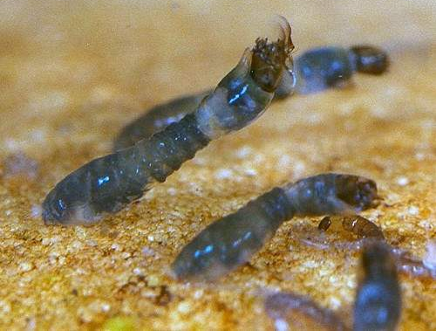
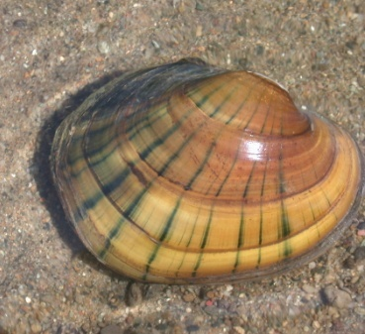
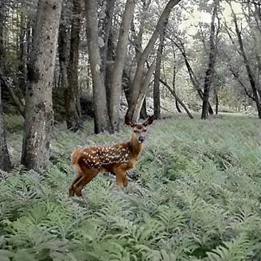
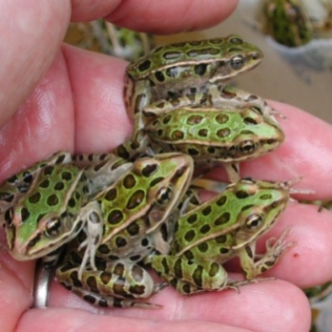
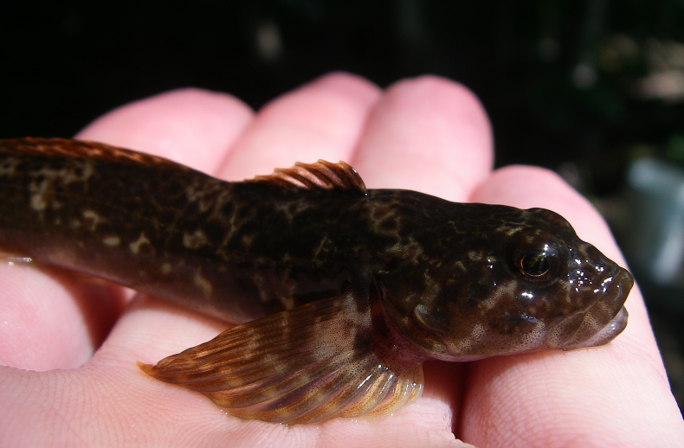
Rivers and adjacent riparian areas serve as some of the most biologically productive and diverse habitat in the state.

Slide 9
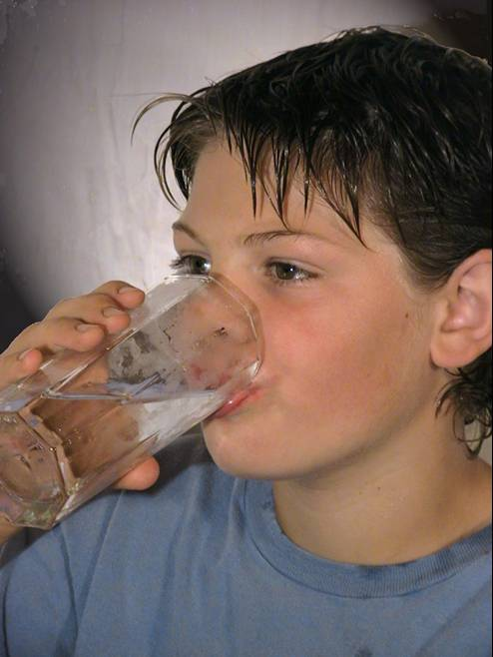
Healthy rivers can provide clean drinking water for human consumption.

Slide 10
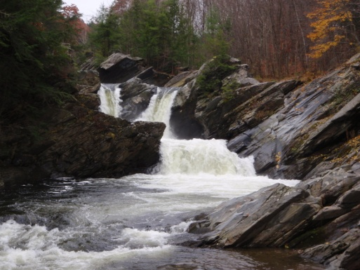
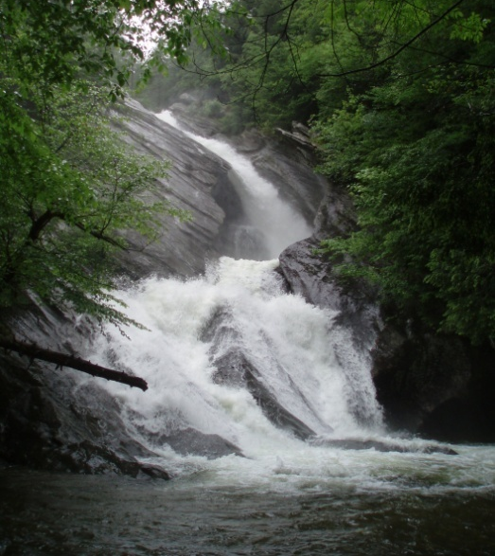
Vermonters and tourists alike are drawn to and rejuvenated by the scenic beauty of Vermont’s rivers.

Slide 11
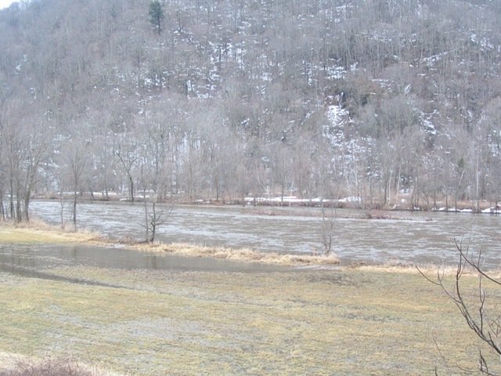
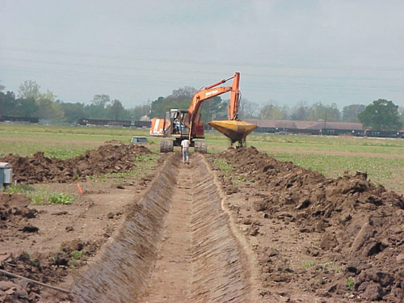
Stable rivers serve as self maintaining drainage networks that transport millions of gallons of water from mountains to lakes and ponds. Consider the cost of constructing and maintaining such a drainage system.

Slide 12
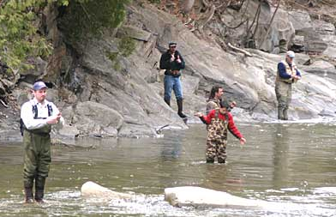
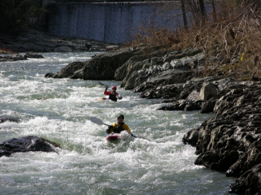
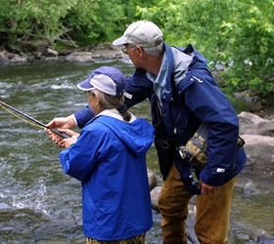
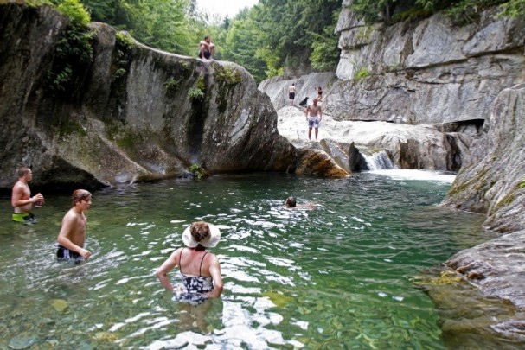
Angling, boating and swimming are part of Vermont’s recreational heritage and overall economy. These activities play an important role in defining our quality of life and shaping our culture and generate substantial economic activity.
The US Fish and Wildlife Service estimates that $131,000,000.00 was spent on fishing related expenditures in 2011 alone.

Slide 13
Questions:
What values are provided by rivers?
Habitat
Click For Answer
Clean Water
Click For Answer
Scenic Beauty
Click For Answer
Self Maintaining Drainage
Click For Answer
Recreation
Click For Answer

Slide 14
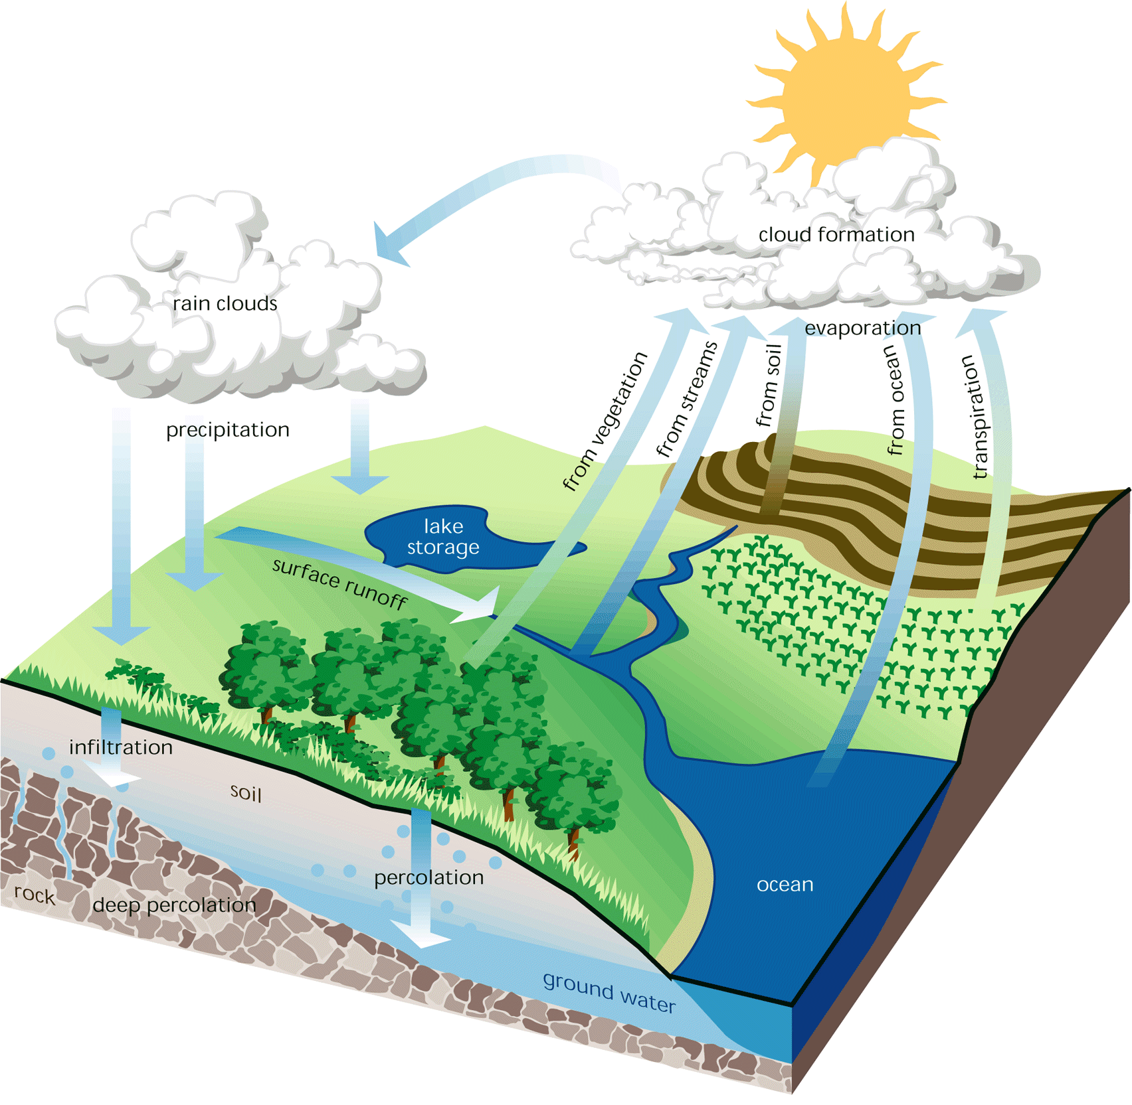
The size, shape and movement of a river are dictated by the water and sediment delivered to it from its watershed (the surrounding landscape) and are therefore a reflection of the characteristics of that watershed.

Slide 15
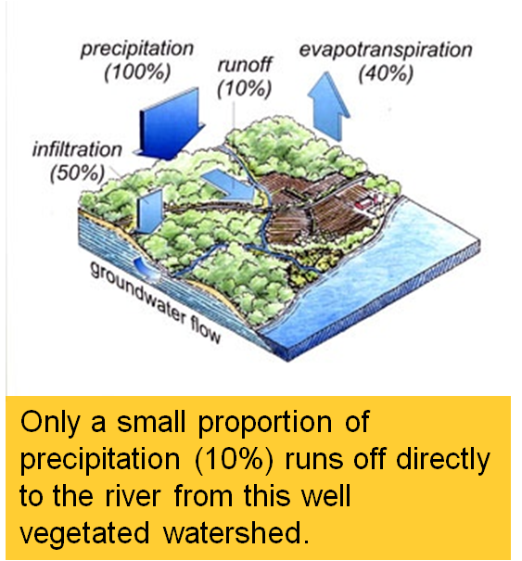
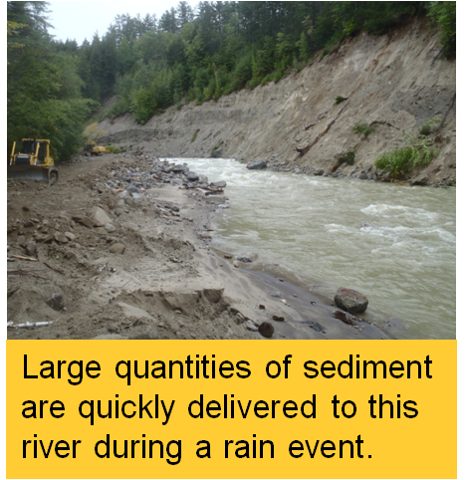
The hydrologic and sediment regimes of a river describe the amount and rate at which water and sediment enter and move through the river.

Slide 16
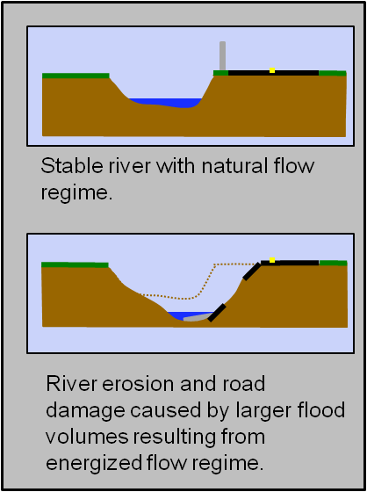
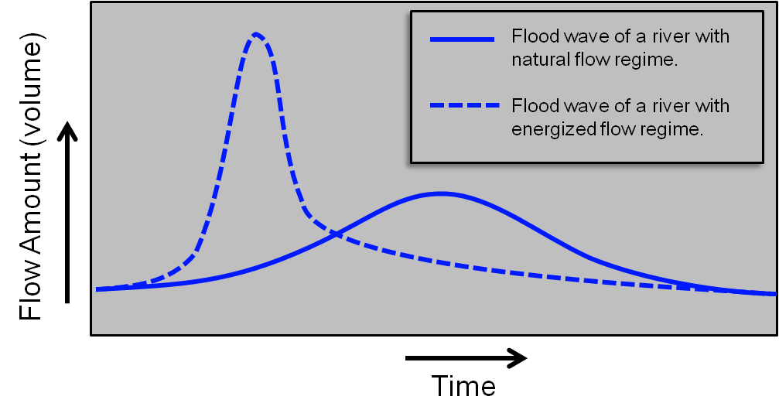
When changes to a watershed shorten the time it takes rainfall to reach the river, the flood volume in the river becomes concentrated and develops a heightened peak. Higher floods result in river erosion.

Slide 17
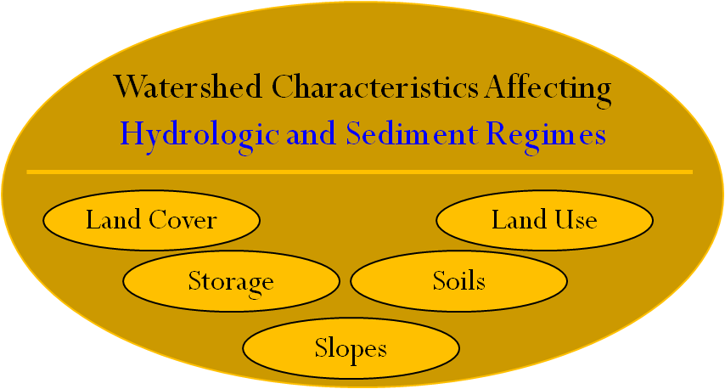
The hydrologic and sediment regimes are affected by certain characteristics of the watershed.

Slide 18
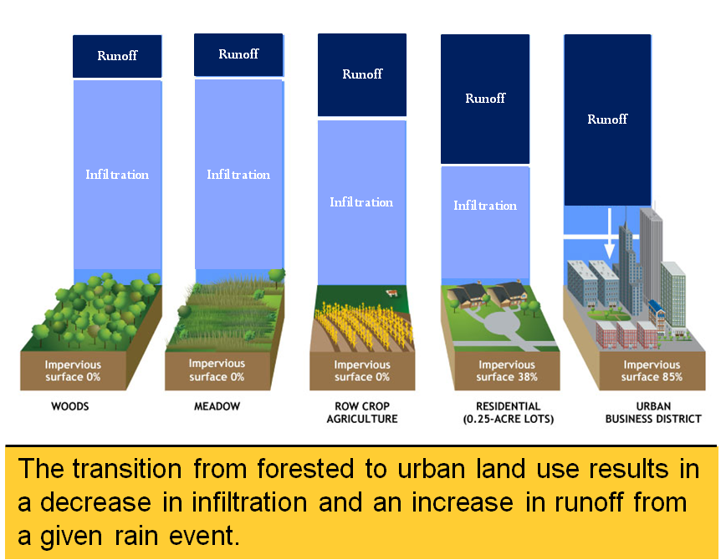
Hydrologic and sediment regimes are strongly affected by land use and land cover.

Slide 19
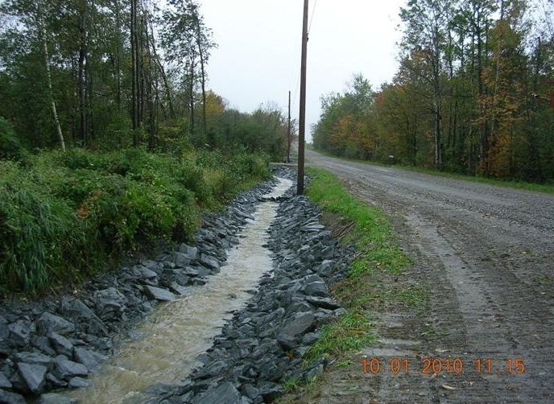
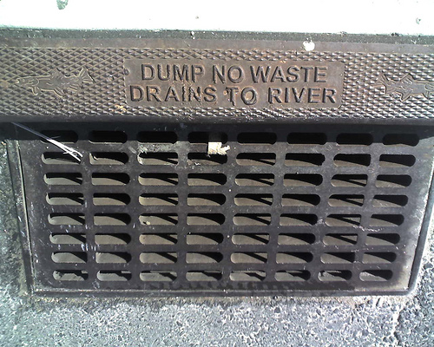
Land uses that require constructed drainage networks increase the rate at which rainwater is delivered to the river.

Slide 20
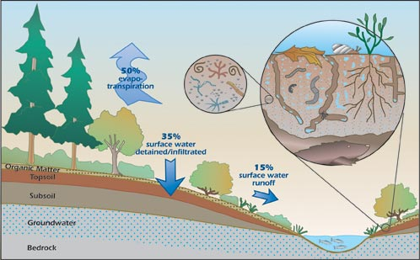
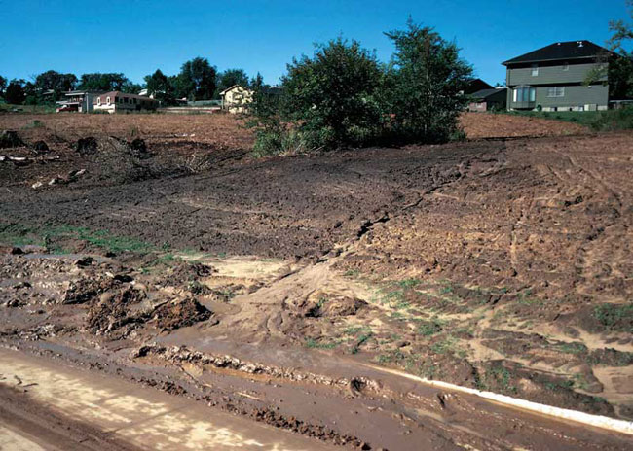
Land cover such as vegetation absorbs rainwater and prevents erosion of sediment greatly reducing the amounts of each that are delivered to the river.

Slide 21
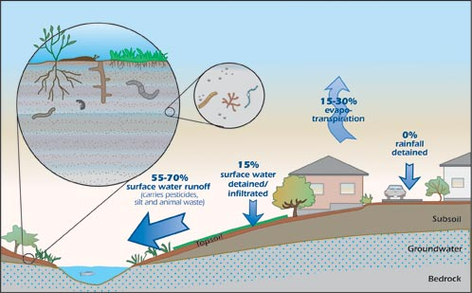
Land cover such as pavement and other impervious surfaces rapidly shed the majority of rainwater, resulting in a river that rises more dramatically in response to rain and snowmelt events.

Slide 22
Lakes, ponds, wetlands and floodplains provide storage of runoff during storm and snowmelt events.

Slide 23
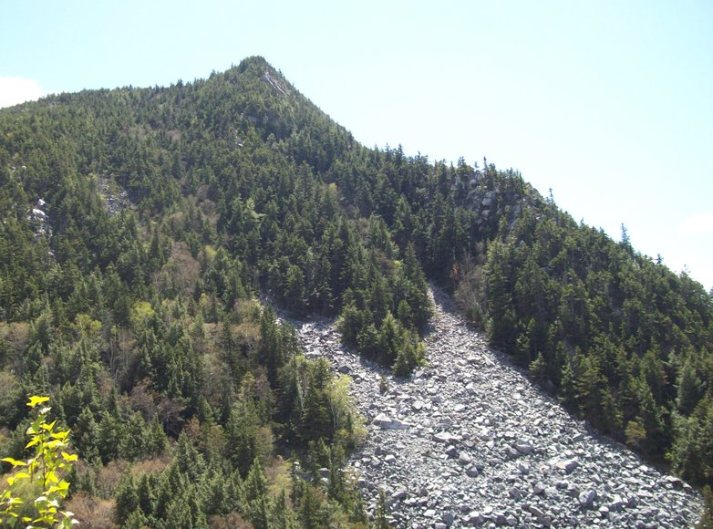
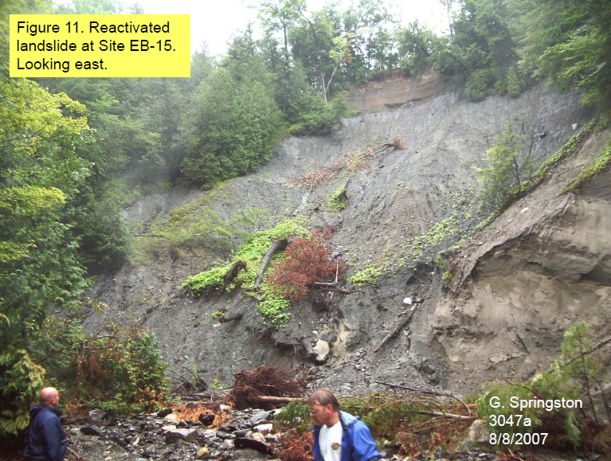
Steep slopes shed water more rapidly and produce more landslides and other erosional events than flat slopes.

Slide 24
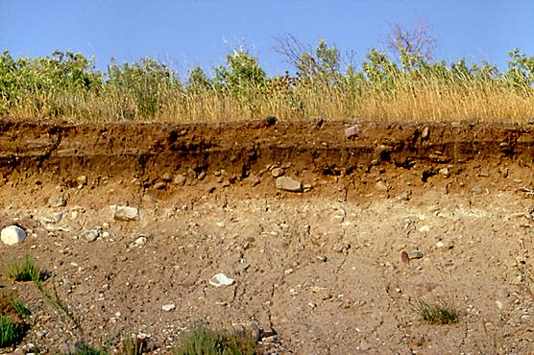
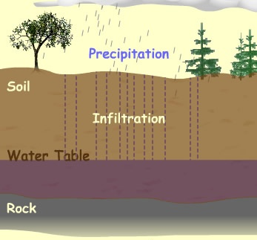
Thick organic Soils soak up rainwater and snowmelt and resist the erosive forces of flowing water.

Slide 25
Wetland Storage, Soils and the Hydrologic Regime of the Otter Creek
(Click here to play video.)
Notes:
Video 1

Slide 26
Questions:
The hydrologic regime describes the amount and rate at which _______________ is delivered to the river from its watershed?
The sediment regime describes the amount and rate at which ______________ is delivered to the river from the watershed?
What characteristics of a watershed affect the hydrologic and sediment regimes?
Water
Click For Answer
Sediment
Click For Answer
Land Cover
Land Use
Soils
Click For Answer
Click For Answer
Click For Answer
Slopes
Storage
Click For Answer
Click For Answer

Slide 27
Lesson 2: Understanding River Behavior

Slide 28
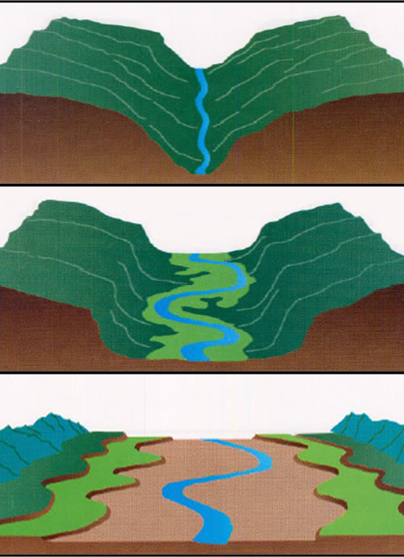
A river’s morphology is simply its shape. The morphology of a river is most strongly influenced by its Valley setting as defined by valley slope, valley width and geology.

Slide 29
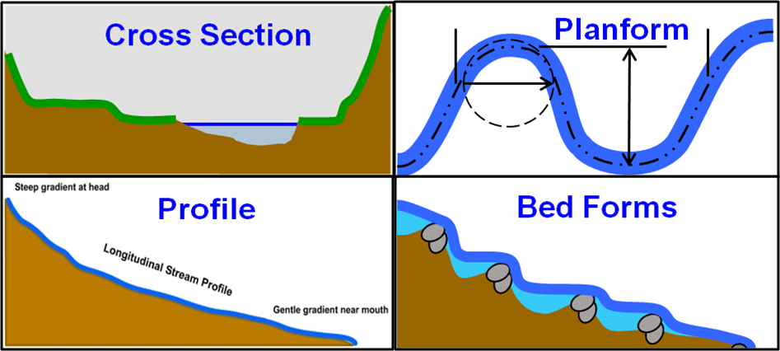
A river’s morphology is described by its:
Cross Section
Profile
Planform and
Bedforms

Slide 30
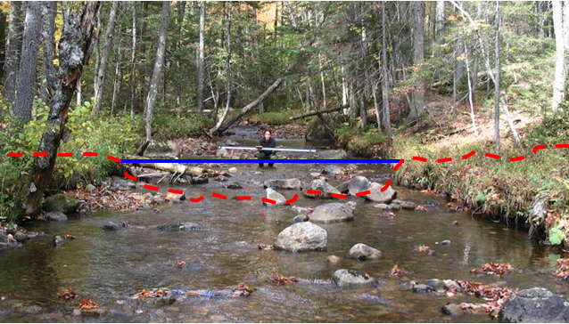
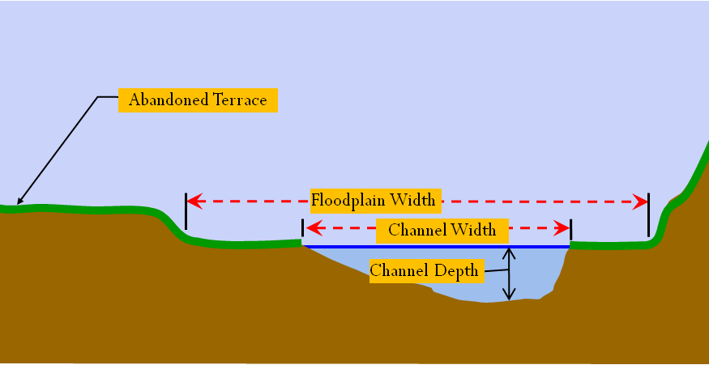
The cross section includes the width and depth of the floodplain and channel.

Slide 31
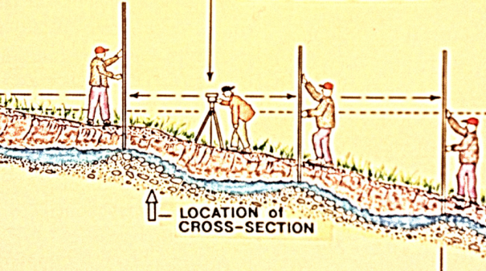
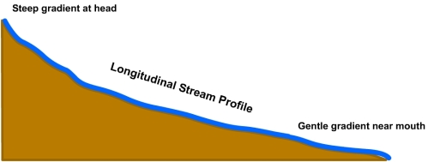
The longitudinal profile is a detailed description of the channel slope.

Slide 32
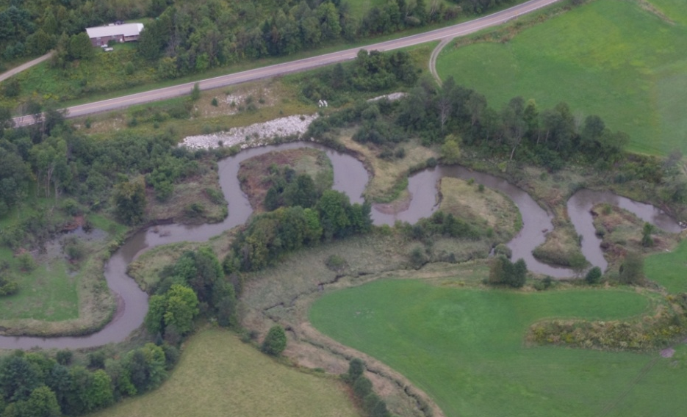
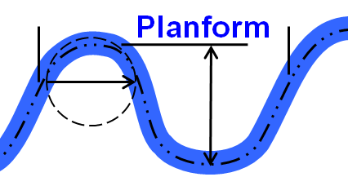
Planform describes channel sinuosity and the shape of a river’s meanders or bends.
Slope is a function of Planform
high sinuosity = lower slope
low sinuosity = greater slope
Notes:
Revised V4

Slide 33
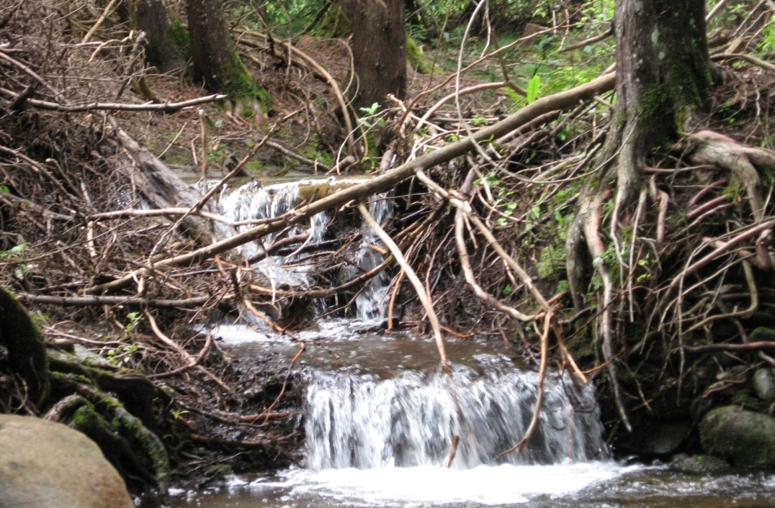
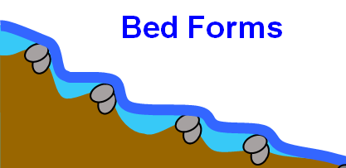
The bedform is a description of the vertical undulations or ups and downs of the bed and the size of the boundary materials such as gravels, cobbles and boulders that are part of those undulations.

Slide 34
Questions:
The width and depth of the river and its floodplain are described by what aspect of its morphology?
The slope of the river is described by what aspect of its morphology?
What aspect of a river’s morphology describes the vertical undulations of its bed?
Cross Section
Click For Answer
Longitudinal Profile
Click For Answer
Bedform
Click For Answer

Slide 35
As discussed in Lesson 1, hydrologic and sediment regimes describe the amount and rate at which flow and sediment are delivered to the river. In the river the power of the flow overcomes the resistance of the sediment and transports it downstream, thereby shaping the river.
Notes:
Revised V4

Slide 36
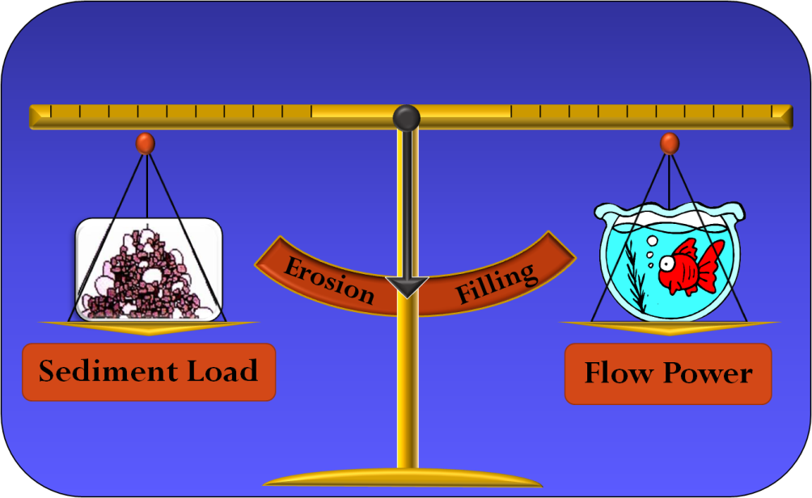
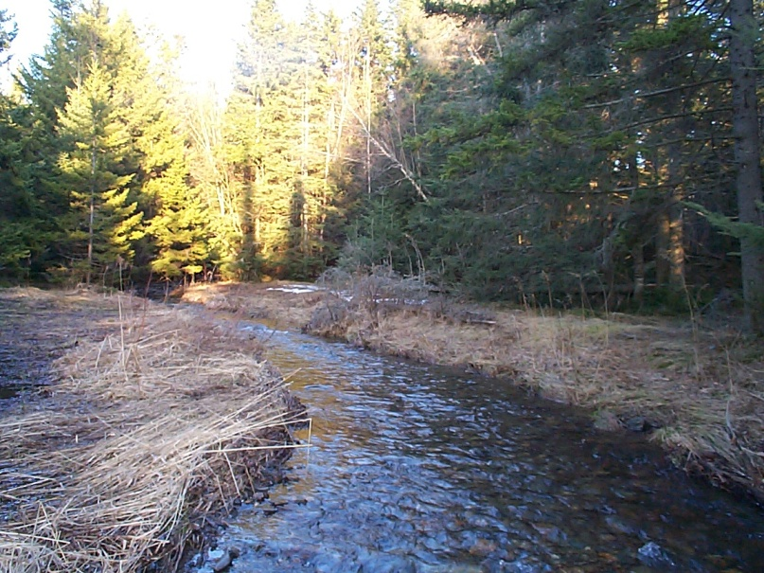
When the flow power is sufficient to transport the sediment load, the river is in balance or equilibrium, meaning it is generally stable over time.

Slide 37
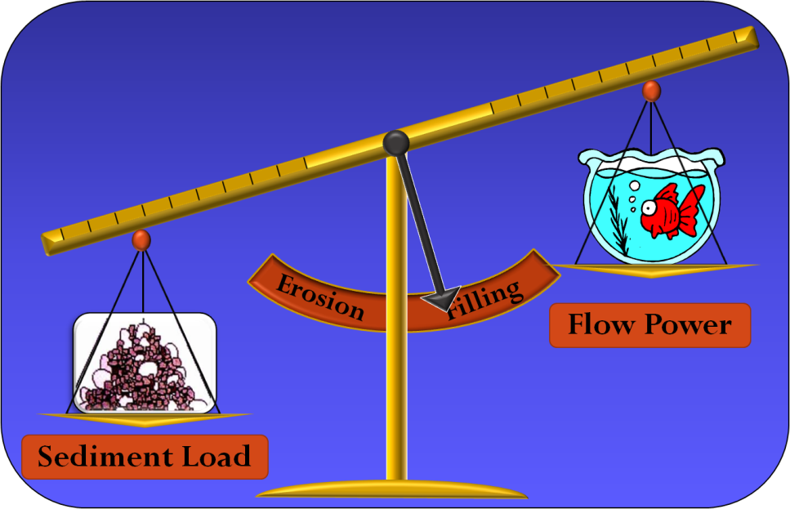
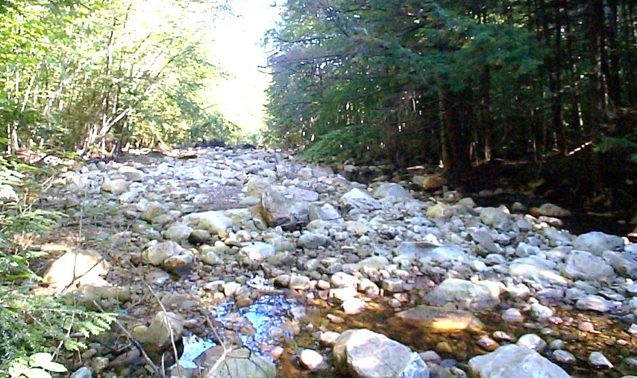
When the flow power is less than what is necessary to transport the sediment load, the channel aggrades or fills in.

Slide 38
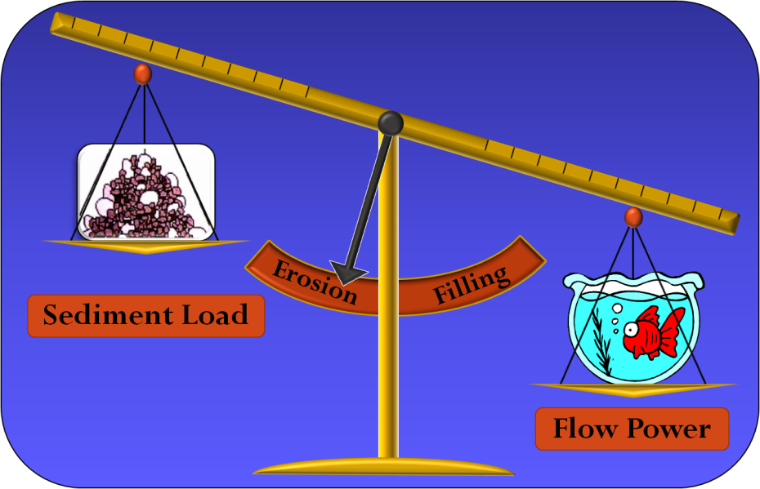
When the flow power is greater than what is necessary to transport the sediment load, the channel degrades or erodes, becoming larger.

Slide 39
Flow power is determined by the following factors:
Amount of Flow (Volume)
Flow Depth
Slope

Slide 40
Volume, depth and slope are directly related to flow power. If any of these factors increase, the flow power will increase and the river will degrade.

Slide 41
Depth depends not only on the discharge but also the channel width. A wider channel will contain a given amount of flow at a lower depth than a narrower channel will.
Wider Channel = Less Power
Narrower Channel = More Power

Slide 42
Where rivers are well connected to floodplains, high flows are able to spread out across those floodplains thereby reducing the flow depth and power in the channel during high flow events.
Notes:
Figure Revised V4

Slide 43
Slope depends not only on the valley slope but also the extent to which the channel meanders back and forth across the valley.
Notes:
Revised V4

Slide 44
Resistance is determined by the following factors:
Sediment Size
Sediment Amount (Volume)
Roughness

Slide 45
Sediment size, sediment volume and roughness are directly related to resistance. If any of these factors increase, the resistance will increase and the river will aggrade.

Slide 46
Roughness is created by bed forms such as steps and pools which dissipate the energy of the flow thereby reducing erosion of the channel.

Slide 47
Roughness is created by meanders which cause the flow to spiral, slowing it down and reducing its energy.

Slide 48
Roughness is created by gravel bars which are the first sediments to be transported during high flows and thereby absorb energy of the flow that would otherwise work to erode the boundary materials.

Slide 49
Roughness is created by large woody debris that creates a physical obstacle to the flow thereby slowing and dissipating its energy.

Slide 50
Bed forms, meanders, gravel bars and woody debris are all important components of habitat features for fish and other aquatic wildlife.

Slide 51
The Role of Bedforms and Floodplains in Moderating Flow Power
(Click here to play video.)
Notes:
Video 11

Slide 52
In summary, river equilibrium requires that the channel have the right combination of depth, slope and roughness to create just enough flow power to transport the sediment load, but where the channel does not move vertically i.e., erode or fill in over time.
Notes:
Revised V4

Slide 53
Lane’s Balance and Equilibrium
(Click here to play video.)
Notes:
Video 2

Slide 54
Questions:
What factors determine how much power the flow contains?
What is the term used to describe the condition in which the flow power is just great enough to transport all of the sediment without filling in or eroding?
Discharge
Depth
Slope
Roughness
Click For Answer
Click For Answer
Click For Answer
Click For Answer
Equilibrium
Click For Answer

Slide 55
When subtle changes occur within a watershed or river that affect its equilibrium, one or more of the remaining factors will adjust such that the balance between flow power and sediment load is restored.
Such adjustments occur frequently without consequence and typically go unnoticed.
Notes:
Revised V4

Slide 56
Sudden large scale changes in a watershed and/or river can result in dramatic disequilibrium which persists for tens to hundreds of years before equilibrium is restored. This five stage process is know as channel evolution.

Slide 57
Channel Evolution
(Click here to play video.)
Notes:
Video 12

Slide 58
Using Lane’s Balance and the Channel Evolution Model to Predict Channel Adjustments
(Click here to play video.)
Notes:
Video 3

Slide 59
Questions:
What is the long term process that a river which has been destabilized by sudden and major watershed and/or channel changes goes through to reach a new equilibrium condition?
What are the consequences of channel evolution?
.
Channel Evolution
Click For Answer
Increased erosion damages.
Degradation of aquatic habitat.
Degradation of water quality.
Click For Answer
Click For Answer
Click For Answer

Slide 60
Lesson 3: Rivers and Human Developments

Slide 61
The flood-related processes, erosion and deposition, are the physical adjustments by which rivers maintain an equilibrium condition.
Notes:
Revised V4

Slide 62
Ironically, those flood processes, which erode and deposit sediment, form level lands that are the most easily developed for roads and buildings, and, at the same time, are the most hazardous.
Notes:
Revised V4

Slide 63
Managing public infrastructure in erodible, hazardous areas requires the knowledge to minimize conflicts with the channel adjustment processes imperative to the maintenance of equilibrium conditions.
For instance:
How does road and bridge infrastructure change flow and sediment regimes or channel slope, depth, and roughness and cause disequilibrium, where severe erosion hazards may follow?
Notes:
Revised V4
V2 Slide 61 has been removed

Slide 64
Flooding, Channel Adjustments and Erosion Hazards
(Click here to play video.)
Notes:
Video 4

Slide 65
Questions:
What river processes are responsible for much of Vermont’s flat landscapes?
What type of flood damage has resulted in the greatest loss in Vermont?
Flooding
Erosion
Click For Answer
Click For Answer
Erosion Damage
Click For Answer

Slide 66
For centuries we have attempted to control rivers in order to settle conflicts between the natural adjustments of rivers and human land uses and developments. This approach has had consequences.

Slide 67
Historic watershed-scale land cover changes have dramatically changed flow and sediment regimes, thereby altering river equilibrium.

Slide 68
Land cover changes such as the conversion of agricultural lands to urban, continue to alter watershed hydrologic regimes today.

Slide 69
River straightening to make way for roads and other developments has resulted in increased channel slopes thereby altering the equilibrium of the river.

Slide 70
Channel dredging and armoring has altered the depth and roughness of channels thereby creating river disequilibrium.

Slide 71
Dredge and armor activities have also significantly degraded the habitat value of rivers.

Slide 72
These land use and channel management activities have resulted in significant channel evolution.
Of 1,500 river miles assessed in Vermont, 75% have been found to be in the incising, widening and stabilizing stages of the evolution process.

Slide 73
A History of River Management
(Click here to play video.)
Notes:
Video 5

Slide 74
Questions
What river process has been triggered by the widespread watershed and river alterations traditionally implemented to settle conflicts between river adjustments and human land uses and developments.
What percentage of the 1,500 miles of river assessed by the River Management Program has been found to be in an unstable stage of channel evolution?
Channel Evolution
Click For Answer
75%
Click For Answer

Slide 75
Lesson 4: River Management Going Forward

Slide 76
If we can begin to use our understanding of rivers to work with their natural processes and manage them toward the equilibrium condition we can greatly reduce erosion hazards and increase public safety, improve fish and wildlife habitat and protect water quality.

Slide 77
Managing for equilibrium requires the planning for future development with consideration to maintaining stable hydrologic and sediment regimes.

Slide 78
Managing for equilibrium requires respect for river floodplains so they may serve their critical energy dissipation role and provide room for rivers to adjust as necessary to maintain an equilibrium condition.

Slide 79
Managing for equilibrium requires design and maintenance of roads and crossings with consideration to the channel depth, slope and roughness factors that determine flow power and the erosion and deposition processes that govern equilibrium conditions.
Notes:
Revised V4

Slide 80
Managing For Equilibrium: Activities to Avoid
Notes:
Revise V4

Slide 81
Going Forward: Managing Rivers Toward the Equilibrium Condition
(Click here to play video.)
Notes:
Video 4

Slide 82
Questions
How can we manage our rivers for equilibrium when designing and building transportation infrastructure and other developments?
What landscape feature must we protect if we are to manage our rivers for equilibrium and thereby reduce flood future flood damages?
By Considering the factors at play in maintaining river equilibrium.
Click For Answer
Floodplains
Click For Answer

Slide 83
River Processes and Management In Summary
Rivers have a natural level of stability that is realized when the power of the river flow is in equilibrium with the sediment load.
This balance can be tipped when activities on the landscape or in the river change the amount of flow and sediments delivered to the rivers and/or the amount of power created by the flow and resistance provided by the river channel.
When the balance is tipped, the river enters a disequilibrium condition and potentially a channel evolution process and the threat to property and developments adjacent to the river is increased.
Working with the natural tendencies of rivers to manage for equilibrium is the most cost effective way to reduce river related damages and threats to public safety.

Slide 84
Thank You for Participating in
The Vermont
Rivers and Roads Training Program
For more information on the Rivers and Roads Training Program
or technical assistance contact:
Shayne Jaquith:
(802) 490-6154
shayne.jaquith@state.vt.us
For more information about the Vermont River Management Section visit us at http://www.anr.state.vt.us/dec/waterq/rivers.htm
For a complete listing of River Management Section staff contact info. see http://www.anr.state.vt.us/dec/waterq/contacts.htm#rivers

